Slide 1
Statistical Procedures Covered in this Course
Ordinary Least Squares regression
Logistic regression
Cluster analysis
Exploratory factor analysis
Path analysis, confirmatory factor analysis, and structural equation modeling

Slide 2
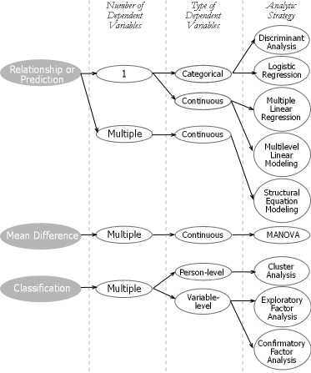

Slide 3
Fundamental Concepts

Slide 4
Hypothesis Testing
Null or statistical hypothesis, denoted by H₀
Scientific, alternative, or research hypothesis, denoted by H₁

Slide 5
Types of Decisions and Errors
 | Decision
State of Nature (reality) | Fail to reject H₀ | Reject H₀
H₀ is true | Correct decision (1 – α) | Type I error (α)
H₀ is false | Type II error (β) | Correct decision (1 – β) = power

Slide 6
Example
A man is on trial for murder;
The null hypothesis
What are the possible decisions
Hypothesis testing framework
 | Person Not guilty | Person is guilty
Jury Decides Person Not guilty | Correct | Type I error
Jury Decides Person Guilty | Type II error | Correct
Notes:
Under the law, the defendant is presumed innocent until “proven” guilty
Similarly, in hypothesis testing, the null hypothesis is assumed to be true
In social science, as in the law, nothing is ever proven to be true, this is all probabilistic

Slide 7
Statistical versus Practical Significance
Statistical significance
  Determined through null hypothesis significance testing
Practical significance
  Measured by effect size
Legal significance
  Measured by the weight of the evidence
    Beyond a reasonable doubt
    Probable cause

Slide 8

Correlation & Simple Linear Regression
Social Work Statistics II
Week 3

Slide 9
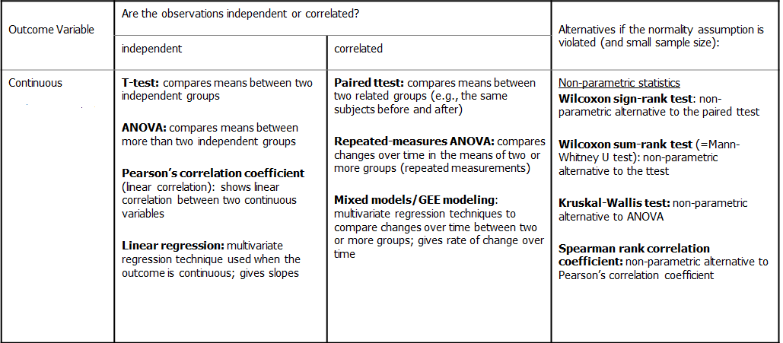
Basic Statistics for Continuous Variables

Slide 10
Correlation analysis
Measures the degree of linear relationship between two continuous variables, x and y
We have a linear relationship between x and y if a straight line drawn through the points provides the most appropriate approximation to the observed relationship
We measure how close the observations are to the straight line that best describes their linear relationship by calculating the Pearson product moment correlation coefficient, usually simply called the correlation coefficient, denoted “r” or “rho” (ρ)

Slide 11
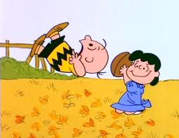
Faulty Analyses
Correlation does not equal causation
There are rules that determine causal effects
Data is often incorrectly analyzed in addition to presented in different ways

Slide 12
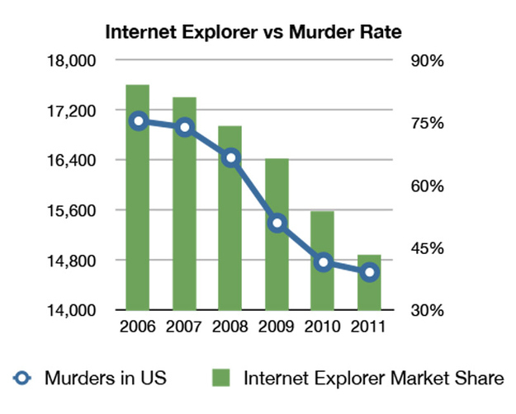
Confusing Correlation and Causation
Correlation = covariation (co-occurrence of change on two variables)
  This tells us nothing about cause (why the two variables changed)
Causation: Change in one variable RESULTS IN change in another
Notes:
Obesity and credit debt – looks like debt increases with obesity and murders decrease with increasing internet explorer market shares
What is the problem here? What are some other explanations…
If you can come up with another explanation – a third variable that explains the relationship between two things, that is known as spuriousness.

Slide 13
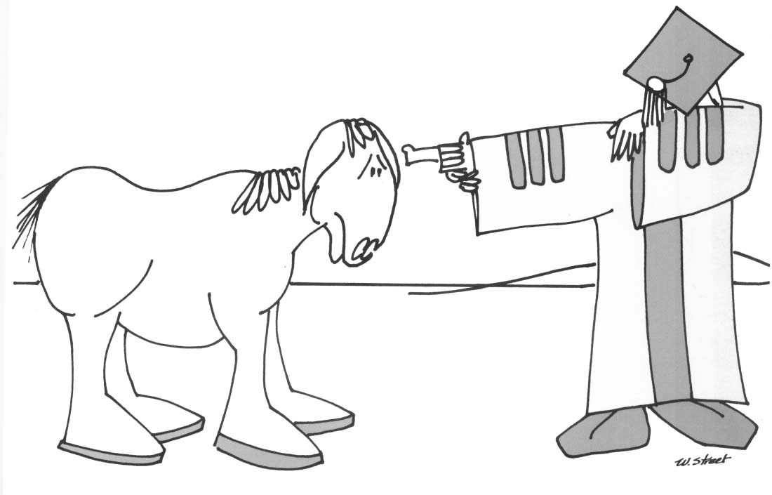
  Correlation & Causation, blah blah (use common sense)
“There’s a significant NEGATIVE correlation between the number of mules and the number of academics in a state, but remember, correlation is not causation”
Often used as means for prediction, correlation tells us how related two variables are
However, note that even though two variables may be highly correlated, you should not assume that one variable causes the other
Note : no other analysis implies correlation either
  Ex. Regression analysis is a method of prediction, but it does not imply causation, but merely correlation (albeit a partial correlation)
The question becomes: what other variable is ‘causing’ the observed relationship
When might we be more confident that an observed correlation is causal?

Slide 14
Scatter Plots of Various Correlations
Strong relationships
Weak relationships
Y
Y
X
X
Y
Y
X
X
Notes:
Positive correlations – occur when both variables move in the same direction (e.g., as SAT scores increase, so to do GPAs, even if very slightly).
Negative Correlations – occur when one variable increases, the other decreases (e.g., as age increases, the number of speeding tickets decrease)

Slide 15
Scatter Plots of Various Correlations
Y
Y
Y
X
X
X
r = -1
r = -.6
r = 0
Y
Y
Y
X
X
X
r = +1
r = +.3
r = 0

Slide 16

Scatter Plots of Various Correlations
Linear relationships
Curvilinear relationships
Y
Y
$$ρ=0$$
X
X
Y
Y
X
X

Slide 17
Demonstrating Causation
4 requirements to logically infer a causal relationship
Covariation--statistical association: if A changes, B must also change. This is necessary, but not sufficient.
  Not enough alone to show cause.
Time order--IV must come before DV
  big problem in cross-sectional surveys.
  Note: sometimes you can make reasonable inferences
Nonspurious--no third factor can explain the covariation
  Ice cream and violent crime
Theory--logical explanation of the relationship

Slide 18
Common misinterpretations: where does causation fail?
Poverty is a major source of child welfare involvement
Children who are abused have higher risk of adult criminal behavior
Victims of domestic violence are more likely to be housing insecure (i.e., be evicted)
Homeless individuals are likely to have physical and mental health problems
People who are highly educated make more money
Drug overdoses increased during the COVID-19 pandemic
Notes:
Oftentimes the effects are very small, some a “significant” finding must be interpreted in light of effect sizes → small effect sizes means that it works that way for some people not many
Oftentimes the effect of one factor on another is indirect, but you are observing a direct relationships
Oftentimes these relationships are taken to be deterministic when they are probabilistic

Slide 19
General
Requirements
ID | Age | Score
1 | 8 | 7
2 | 6 | 2
3 | 9 | 6
4 | 7 | 6
5 | 7 | 8
6 | 8 | 5
7 | 5 | 3
8 | 5 | 5
Two or more continuous variables,
Not necessarily directional (one causes the other)
Linear Relationship (or at least ordinal)

Slide 20
Correlation
A correlation is a relationship between two variables. The data can be represented by the ordered pairs (x, y) where x is the independent (or explanatory) variable, and y is the dependent (or response) variable.
A scatter plot can be used to determine whether a linear (straight line) v. some other relationship exists between two variables.
y
2
x
2
4
6
Example:
x | 1 | 2 | 3 | 4 | 5
y | – 4 | – 2 | – 1 | 0 | 2
–2
– 4

Slide 21

Covariance (review & example)
cov(X,Y) > 0 → X and Y are positively correlated
cov(X,Y) < 0 → X and Y are inversely correlated
cov(X,Y) = 0 → X and Y are independent, or uncorrelated
$$cov\left(x,y\right)=\frac{\sum_{i=1}^{n}{ (x_{i}−\overline{X})(y_{i}−\overline{Y})}}{n−1}$$
Calculate the covariance between these two variables
x | 1 | 2 | 3 | 4 | 5
y | – 4 | – 2 | – 1 | 0 | 2

Slide 22

Correlation = Standardized Covariance
$$\hat{r}=\frac{COV(x,y)}{\sqrt{\operatorname{var}{x}}\sqrt{\operatorname{var}{y}}}=$$
$$\frac{\frac{\sum_{i=1}^{n}{(x_{i}−\bar{x})(y_{i}−\bar{y})}}{n−1}}{\sqrt{\frac{\sum_{i=1}^{n}{(x_{i}−\bar{x})^{2}}}{n−1}}\sqrt{\frac{\sum_{i=1}^{n}{(y_{i}−\bar{y})^{2}}}{n−1}}}$$

Slide 23


Simpler calculation formula…
$$\hat{r}=\frac{\frac{\sum_{i=1}^{n}{(x_{i}−\bar{x})(y_{i}−\bar{y})}}{n−1}}{\sqrt{\frac{\sum_{i=1}^{n}{(x_{i}−\bar{x})^{2}}}{n−1}}\sqrt{\frac{\sum_{i=1}^{n}{(y_{i}−\bar{y})^{2}}}{n−1}}}$$
$$=\frac{\sum_{i=1}^{n}{(x_{i}−\bar{x})(y_{i}−\bar{y})}}{\sqrt{\sum_{i=1}^{n}{(x_{i}−\bar{x})^{2}}}\sqrt{\sum_{i=1}^{n}{(y_{i}−\bar{y})^{2}}}}$$
$$=\frac{SS_{xy}}{\sqrt{SS_{x}SS_{y}}}$$
Numerator of covariance
$$\hat{r}=\frac{SS_{xy}}{\sqrt{SS_{x}SS_{y}}}$$
Numerators of variance

Slide 24
Yet another…
The formula can also be expressed as follows, by manipulating the terms
The range of the correlation coefficient is −1 to 1. If x and y have a strong positive linear correlation, r is close to 1. If x and y have a strong negative linear correlation, r is close to −1. If there is no linear correlation or a weak linear correlation, r is close to 0.

Slide 25
Calculating a Correlation Coefficient
Calculating a Correlation Coefficient
In Words In Symbols
Find the sum of the x-values.
Find the sum of the y-values.
Multiply each x-value by its corresponding y-value and find the sum.
Square each x-value and find the sum.
Square each y-value and find the sum.
Use these five sums to calculate the correlation coefficient.

Slide 26
Correlation Coefficient
Example:
Calculate the correlation coefficient r for the following data.
x | y | xy | x² | y²
1 | – 3 | – 3 | 1 | 9
2 | – 1 | – 2 | 4 | 1
3 | 0 | 0 | 9 | 0
4 | 1 | 4 | 16 | 1
5 | 2 | 10 | 25 | 4
There is a strong positive linear correlation between x and y.

Slide 27
Correlation Coefficient
Example:
The following data represents the number of hours 12 different students watched television during the weekend and the scores of each student who took a test the following Monday.
a.) Display the scatter plot.
b.) Calculate the correlation coefficient r.
Hours, x | 0 | 1 | 2 | 3 | 3 | 5 | 5 | 5 | 6 | 7 | 7 | 10
Test score, y | 96 | 85 | 82 | 74 | 95 | 68 | 76 | 84 | 58 | 65 | 75 | 50
Continued.

Slide 28
Correlation Coefficient
Example continued:
Hours, x | 0 | 1 | 2 | 3 | 3 | 5 | 5 | 5 | 6 | 7 | 7 | 10
Test score, y | 96 | 85 | 82 | 74 | 95 | 68 | 76 | 84 | 58 | 65 | 75 | 50
y
100
80
60
Test score
40
20
x
2
4
6
8
10
Hours watching TV
Continued.

Slide 29
Correlation Coefficient
Example continued:
Hours, x | 0 | 1 | 2 | 3 | 3 | 5 | 5 | 5 | 6 | 7 | 7 | 10
Test score, y | 96 | 85 | 82 | 74 | 95 | 68 | 76 | 84 | 58 | 65 | 75 | 50
xy | 0 | 85 | 164 | 222 | 285 | 340 | 380 | 420 | 348 | 455 | 525 | 500
x² | 0 | 1 | 4 | 9 | 9 | 25 | 25 | 25 | 36 | 49 | 49 | 100
y² | 9216 | 7225 | 6724 | 5476 | 9025 | 4624 | 5776 | 7056 | 3364 | 4225 | 5625 | 2500
There is a strong negative linear correlation.
As the number of hours spent watching TV increases, the test scores tend to decrease.

Slide 30
Let’s apply
Open the document review.doc
We will re-do these analyses in SPSS (review.sav)
Then we will do them using JASP (review.jasp)

Slide 31
Correlation in SPSS/JASP
We are going to explore correlations between symptoms of PTSD following a traumatic experience
The data asked over 2000 foster youth about Potentially Traumatic Experiences (PTEs)
  PTEs are sexually molested, kidnapping, badly injured or killed, watched badly injured or killed, physically attacked, threatened with a weapon
Symptoms are re-experiencing (intrusive thoughts, distressing dreams, flashbacks, psychological distress, physiological reactivity), arousal problems (sleep, irritability, concentration, hypervigilance, startle), avoidance (avoid thoughts and places) and emotional numbing (diminished interest, feeling detached, restricted affect and foreshortened future)
File: PTSD_foster_care.csv

Slide 32
Compute the Test Statistic
4
Click on
“Regression Tab → Correlation”

Slide 33
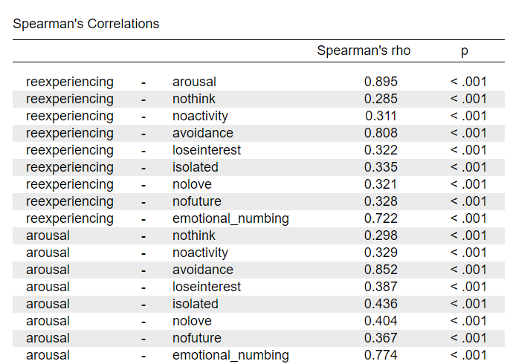
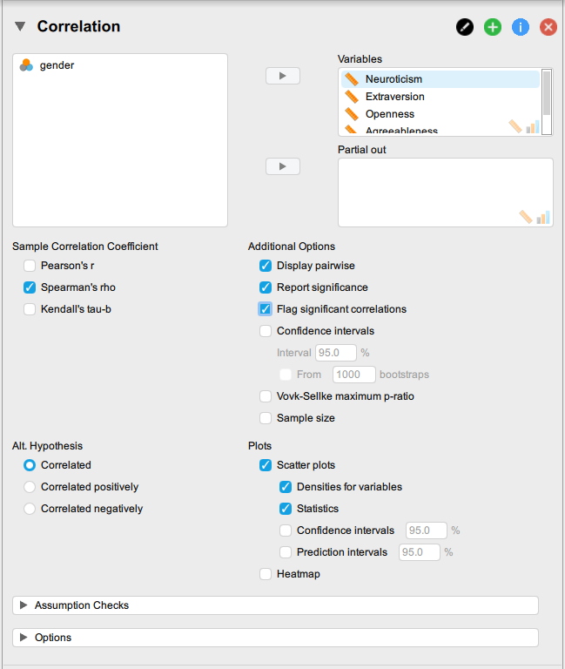
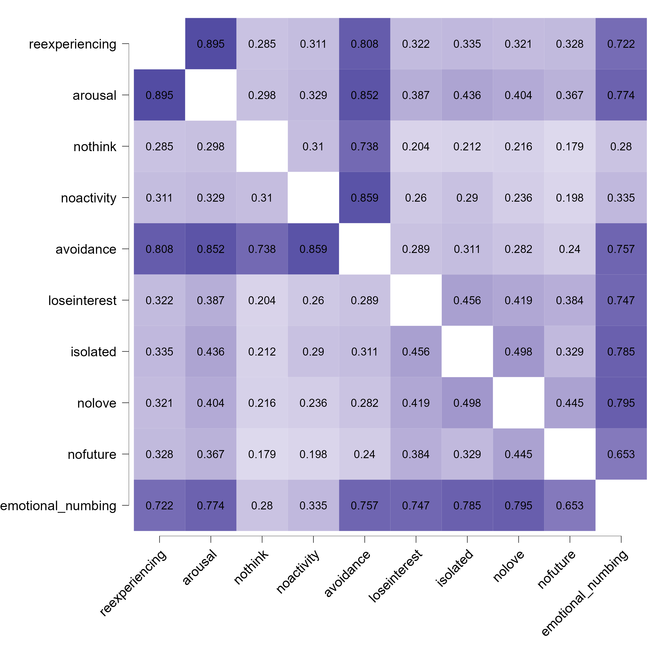
Compute the Test Statistic
4
Results
Bring variables to be correlated over here

Slide 34

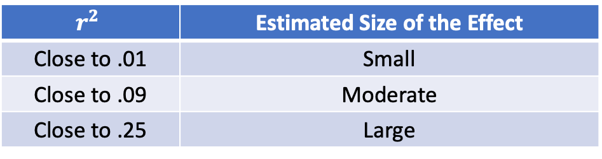
Compute an Effect Size and Describe it
5
One of the main effect sizes for correlation is r²
$$r_{ }^{2}={\left(r\right)}^{2}$$
$$r_{ }^{2}$$ | Estimated Size of the Effect
Close to .01 | Small
Close to .09 | Moderate
Close to .25 | Large
Notes:
Can also use Cohen’s d here as well for each mean difference

Slide 35
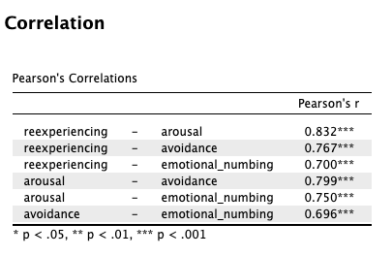
Interpreting the results
6
Example write-up
Correlations were computed among Symptoms are re-experiencing, arousal problems, avoidance and emotional numbing in over 2,000 foster care youth who experienced a potentially traumatic event. The correlations between all symptom pairs were statistically significant at the alpha = .05 level. For example, the correlation coefficient between re-experiencing and arousal was positive and highly significant indicating that as re-experiencing increases so do symptoms of arousal (r = .832, p < .001). Etc.

Slide 36
Overview of next 3-4 weeks
Ordinary Least Squares
  Simple linear regression
    Mechanics (today)
  Multiple linear regression
  Power
  Effect Size
  Assumptions
Examples and Applications

Slide 37
Continuous Variables
Outcome Variable | Are the observations independent or correlated? |  | Alternatives if the normality assumption is violated (and small sample size):
 | independent | correlated
Continuous (e.g. pain scale, cognitive function) | T-test: compares means between two independent groups ANOVA: compares means between more than two independent groups Pearson’s correlation coefficient (linear correlation): shows linear correlation between two continuous variables Linear regression: multivariate regression technique used when the outcome is continuous; gives slopes | Paired ttest: compares means between two related groups (e.g., the same subjects before and after) Repeated-measures ANOVA: compares changes over time in the means of two or more groups (repeated measurements) Mixed models/GEE modeling: multivariate regression techniques to compare changes over time between two or more groups; gives rate of change over time | Non-parametric statistics Wilcoxon sign-rank test: non-parametric alternative to the paired ttest Wilcoxon sum-rank test (=Mann-Whitney U test): non-parametric alternative to the ttest Kruskal-Wallis test: non-parametric alternative to ANOVA Spearman rank correlation coefficient: non-parametric alternative to Pearson’s correlation coefficient

Slide 38
Uses of Regression Analysis
Regression analysis serves 3 major purposes:
    Description
    Prediction
    Control → ceteris paribus
The several purposes of regression analysis frequently overlap in practice

Slide 39
Mechanics
Simple regression analysis is a statistical tool that gives us the ability to estimate the relationship between a dependent variable (usually called y) and an independent variable (usually called x).
  The dependent variable is the variable for which we want to make a prediction
  While various non-linear forms may be used, simple linear regression models are the most common (and the most useless)

Slide 40

Introduction: Linear Regression
Aims to predict the value of an outcome (e.g., violence, PTSD, etc), Y, based on the value of one or more explanatory variables, $X_{1}, …X_{n}$.
Two main questions
  What is the relationship between the Y and Xs, on average?
    The analysis “models” this as a line
    We care about “slope”—size, direction
    Slope=0 corresponds to “no association” (just as in correlation)
  How precisely can we predict Y conditional on certain values of the independent variables?
    Another way to say this: How much of the variation in Y is being explained by X?

Slide 41
Linear regression –Terminology
Outcome, Y
  Dependent variable
  Response variable
Explanatory variable (predictor), X
  Independent variable
  Covariate

Slide 42

Functional Form
Y
The first order linear model
  Y = dependent variable
  X = independent variable
  b = Y-intercept
  m = slope of the line
  Define b, and m
$$Y=mX+b$$
Rise
b
Run
X
Notes:
m = slope → change in Y over change in X

Slide 43
Functional Form
The model has a deterministic and a probabilistic components
House Cost
Building a house costs about
$75 per square foot.
Housing Size | Housing Cost
0 sq. ft. | $25,000
1,000 sq. ft. | $100,000
2,500 sq. ft. | $212,500
House cost = $25,000 + 75(Size)
?
Most lots sell
for $25,000
House size
What is the expected value of the house when the house size is 0?

Slide 44


However, house cost vary even among same size houses!
House cost = 25000 + 75 (Size)
+ ε
House Cost
Most lots sell for $25,000
What types of variables might be part of the error term?
Since cost behave unpredictably, we add a random component.
House size

Slide 45
β₀ and β₁ are unknown population parameters, therefore are estimated from the data.
The first order linear model
  Y = dependent variable
  X = independent variable
  β₀ = Y-intercept (b)
  β₁ = slope of the line (m)
  ε = error variable
Y
Rise
β₁ = Rise/Run
β₀
Run
X

Slide 46
Estimating the model parameters
The estimates are determined by
  drawing a sample from the population of interest,
  calculating sample statistics.
  producing a straight line that cuts through the data.
Y
w
w
w
w
w
w w w w
w
w w
w w
w
X
Question: What should be considered a good line?

Slide 47
The Least Squares (Regression) Line
A good line is one that minimizes the sum of squared differences between the points and the line.

Slide 48
Sum of squared differences =
(2 - 1)² +
(4 - 2)² +
(1.5 - 3)² +
(3.2 - 4)² = 6.89
Sum of squared differences =
(2 -2.5)² +
(4 - 2.5)² +
(1.5 - 2.5)² +
(3.2 - 2.5)² = 3.99
4
(2,4)
w
3
w
(4,3.2)
The smaller the sum of
squared differences
the better the fit of the
line to the data.
2.5
2
w
(1,2)
(3,1.5)
w
1
1
2
3
4

Slide 49

Formal statement of the model
If the scatter plot of our sample data suggests a linear relationship between two variables i.e. we can summarize the relationship by drawing a straight line on the plot.
The values of the regression parameters β₀, and β₁ are not known. We estimate them from data.
  β₀ indicates the intercept of Y
  β₁ indicates the change in the mean response in Y per unit increase in X
X is a known independent variable
Deviations ε are independent N(o, σ²)
Least squares method give us the “best” estimated line for our set of sample data.
$Y= β_{0}+β_{0}$X+ε

Slide 50
Let’s see how this is applied

Slide 51
What Multiple Linear Regression Is and How It Works: Characteristics
Two or more predictor variables and one criterion variable
Additional variables are incorporated via partial and semipartial correlations
Partial correlation: As a three-variable example, represents the linear relationship between X₁ and X₂ independent of the linear influence of X₃
Semipartial (part) correlation: Linear relationship between X₁ and X₂ after that portion of X₂ that can be linearly predicted from X₃ has been removed from X₂

Slide 52
What Multiple Linear Regression Is and How It Works: Characteristics
Unstandardized regression model
Sample multiple linear regression model
  Y_{i} = b₁ X_{1i} + b₂ X_{2i} + ... + b_{m} X_{mi} + a + e_{i}
  Y is the criterion variable
  X_{k}’s are the predictor (or independent) variables where k = 1, ..., m
  b_{k} is the sample partial slope of the regression line for Y as predicted by X_{k}
  a is the sample intercept of the regression line for Y as predicted by the set of X_{k}’s
  e_{i} are the residuals or errors of prediction (the part of Y not predictable from the X_{k}’s)
  i represents an index for an individual or object
Sample prediction model is
  Y'_{i} = b₁ X_{1i} + b₂ X_{2i} + ... + b_{m} X_{mi} + a
Difference in the models:
  Regression model explicitly includes prediction error as e_{i}
  Prediction model includes prediction error implicitly as part of the predicted score Y'_{i} (i.e., there is some error in the predicted values)

Slide 53
What Multiple Linear Regression Is and How It Works: Characteristics
Standardized regression model
Sample standardized linear prediction model
  = sample standardized partial slope
  no intercept term is necessary as the mean of the z scores for all variables is 0
Unstandardized or standardized model?
  Standardized model is not stable from sample to sample
$$z(Y_{i}^{′})=b_{1}^{∗}z_{1i}+b_{2}^{∗}z_{2i}+...+b_{m}^{∗}z_{mi}$$

Slide 54
What Multiple Linear Regression Is and How It Works: Characteristics
Coefficient of multiple determination and multiple correlation
  Tells the proportion of total variation in the dependent variable Y that is explained by the set of predictor variables
  R-squared = .45 → 45% of the variation in Y is explained by Xs
    Example: if we predict GGPA from UGPA and our R-squared is .45
  1 – R-squared

Slide 55
What Multiple Linear Regression Is and How It Works: Characteristics
Significance tests
  Overall: Test of significance of the overall regression model, or alternatively the test of significance of the coefficient of multiple determination
    If H₀ is rejected, then one or more of the individual regression coefficients is statistically significantly different from zero
  Ceteris paribus: Test of the statistical significance of each individual partial slope or regression coefficient, b_{k}

Slide 56
What Multiple Linear Regression Is and How It Works: Characteristics
Methods of entering predictors
  Simultaneous
  Backward elimination
    Forward selection
    Stepwise selection
    All possible subsets regression
    Hierarchical regression

Slide 57
What Multiple Linear Regression Is and How It Works: Characteristics
Nonlinear relationships
  Polynomial models
    First degree polynomial (simple linear regression)
    Second degree polynomial (quadratic)
    Third degree polynomial (cubic)
    Example: entering age (first degree), age-squared (quadratic) or age-cubed (3rd degree)

Slide 58
What Multiple Linear Regression Is and How It Works: Characteristics
Interactions
  An interaction can be defined as occurring when the relationship between Y and X₁ depends on the level of X₂
    In other words, X₂ is a moderator variable

Slide 59
What Multiple Linear Regression Is and How It Works: Characteristics
Categorical predictors
  Dummy coding
  When there are more than two categories to the categorical predictor, multiple dummy coded variables must be created—specifically one minus the number of levels or categories of the categorical variable

Slide 60
What Multiple Linear Regression Is and How It Works
Sample Size

Slide 61
What Multiple Linear Regression Is and How It Works: Sample Size
Sample size considerations differ depending on the research goal—testing a hypothesis test estimating a parameter (Algina & Olejnik, 2000; Maxwell, 2000)
  Larger sample sizes needed for estimation (e.g., Pedhazur, 1997)
Sample size increases as the squared multiple correlation coefficient diminishes (Knofszynski, 2008)
Recommendation: estimate power using power software and to consult current advances based on simulation research such as Knofszynski (2008)

Slide 62
What Multiple Linear Regression Is and How It Works
Power

Slide 63
What Multiple Linear Regression Is and How It Works: Power
In multiple regression, power is a function
  sample size
  number of predictors
  level of significance
  size of the population effect
Recommendation: consult power table or power software

Slide 64
What Multiple Linear Regression Is and How It Works
Effect Size

Slide 65
What Multiple Linear Regression Is and How It Works: Effect Size
Coefficient of multiple determination or multiple correlation coefficient
Squared multiple correlation coefficient which can be used to compute a globalized f²

Slide 66
What Multiple Linear Regression Is and How It Works
Assumptions

Slide 67
What Multiple Linear Regression Is and How It Works: Assumptions
Independence
Homoscedasticity
Normality
Linearity
Fixed X
Noncollinearity

Slide 68
Independence
Due to sampling scheme
Example: I just reviewed a paper that was exploring the impact of county-level correlates and aggregate county-level perceptions of social workers on the outcomes of youth in EFC
The authors used OLS
This is incorrect, why?

Slide 69
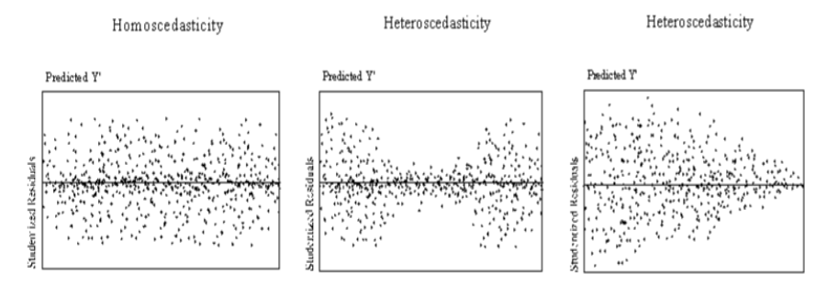
Homoscedasticity

Slide 70
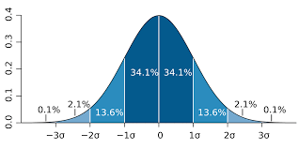
Normality
Be careful, this assumption is about the prediction errors, not the independent variables
May be due to outliers however (which are obviously related to the measurement of the independent variables

Slide 71
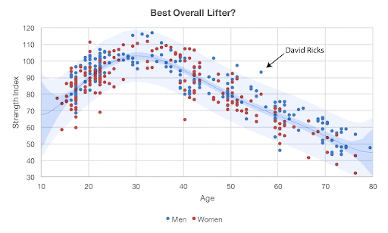
Linearity
There is a linear relationship between Y and X
  Recall correlation
But, we can model nonlinear relationships
Why?

Slide 72
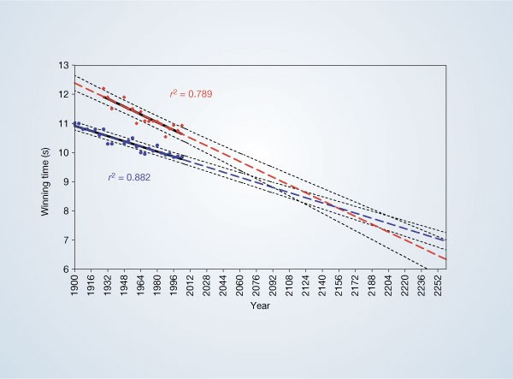
Fixed X
The regression lines are extrapolated (broken blue and red lines for men and women, respectively) and 95% confidence intervals (dotted black lines) based on the available points are superimposed. The projections intersect just before the 2156 Olympics, when the winning women's 100-metre sprint time of 8.079 s will be faster than the men's at 8.098 s.
Tatem, A. J., Guerra, C. A., Atkinson, P. M., & Hay, S. I. (2004). Momentous sprint at the 2156 Olympics?. Nature, 431(7008), 525-525.
  Analyzed athletes performance on the 100 m dash
  Found an interesting pattern: the time it took to run it decreased steadily, such that males and females were getting faster and faster over the years
  Around the year 2156, the lines crossed: sometime mid-century, they predicted, women would outrun men!
  Even though the lines LOOK convincing, they are not truly capturing the underlying pattern of the data… why?

Slide 73
Noncollinearity
Less is more
Always examine correlations – substantial overlap means one should be taken out of the model
But be weary – I learned that the forward/backwards elimination is not a good strategy, why?
Start with theory → test hypotheses → draw conclusions

Slide 74
Mathematical Introduction Snapshot
Example: Can I predict your graduate GPA based on your undergraduate GPA & score on the GRE
Note: Be very very careful about what you CLAIM after the analysis. Your conclusions and policy recommendations can be very detrimental particularly to historically marginalized populations!
You should also ask yourself: Who Cares?

Slide 75
GRE-GPA Example Data
Student | GRE-Total (X₁) | Undergraduate GPA (X₂) | Graduate GPA(Y)
1 | 145 | 3.2 | 4.0
2 | 120 | 3.7 | 3.9
3 | 125 | 3.6 | 3.8
4 | 130 | 2.9 | 3.7
5 | 110 | 3.5 | 3.6
6 | 100 | 3.3 | 3.5
7 | 95 | 3.0 | 3.4
8 | 115 | 2.7 | 3.3
9 | 105 | 3.1 | 3.2
10 | 90 | 2.8 | 3.1
11 | 105 | 2.4 | 3.0

Slide 76
Sample Partial Slope and Intercept
$$b_{1}=\frac{(r_{Y1}−r_{Y2}r_{12})s_{Y}}{(1−r_{12}^{2})s_{1}}=\frac{[.7845−(.7516)(.3011)].3317}{(1−.3011^{2})16.3346}=.0125$$
$$b_{2}=\frac{(r_{Y2}−r_{Y1}r_{12})s_{Y}}{(1−r_{12}^{2})s_{2}}=\frac{[.7516−(.7845)(.3011)].3317}{(1−.3011^{2}).4011}=.4687$$
$$a=\bar{Y}−b_{1}{\bar{X}}_{1}−b_{2}{\bar{X}}_{2}=3.5000−(.0125)(112.7273)−(.4687)(3.1091)=.6337$$

Slide 77
Sample Multiple Linear Regression Model
Y_{i} = b₁ X_{1i} + b₂ X_{2i} + a + e_{i}
Y_{i} =.0125 X_{1i} + .4687 X_{2i} + .6337 + e_{i}
If your score on the GRETOT was 130 and your UGPA was 3.5, then your predicted score on the GGPA would be computed as:
  Y'_{i} = .0125 (130) + .4687 (3.5000) + .6337 = 3.8992

Slide 78
Overall F Test Statistic
Or
The critical value, at the .05 level of significance, is _{.05} F _{2,8} = 4.46
Test statistic exceeds the critical value, so we reject H₀ and conclude that all of the partial slopes are not equal to zero at the .05 level of significance
$$F=\frac{R^{2}/m}{(1−R^{2})/(n−m−1)}=\frac{.9089/2}{(1−.9089)/(11−2−1)}=39.9078$$
$$F=\frac{SS_{reg}/df_{reg}}{SS_{res}/df_{res}}=\frac{0.9998/2}{.1002/8}=39.9122$$

Slide 79
Customize this Template
R code SPSS example and annotated output will be uploaded to Canvas for Week 3

